Slide 1


Optimizing Vegetable Classification with Multilayer Perceptron: A Comparative Study
Deep Learning
pacmann.io
© 2022 – Pacmann AI

Slide 2
Outline
Introduction
Related Work
Experiments
Result and Discussions
Conclusion
References

Slide 3
Introduction
Notes:
Transisi antar outline

Slide 4
Introduction
Indonesia is an agricultural country that is rich in agricultural products. The diversity of vegetables has become an important element in everyday life. With a wide variety of vegetables growing in abundance, sometimes identifying each type of vegetable can be a challenging task. Therefore, the vegetable image classification project provides a practical solution by automatically identifying and distinguishing different types of vegetables based on images.

Slide 5
Related Work
Notes:
Transisi antar outline

Slide 6
Related Work
Israk et al. (2021), DCNN-Based Vegetable Image Classification Using Transfer Learning: A Comparative Study.
Khalid et al. (2012), Date Fruits Classification using MLP and RBF Neural Network.
Sakai et al. (2016), A Vegetable Category Recognition System Using Deep Neural Network.
Sukheta et al. (2021), Classification of fruits and vegetables using ResNet model.

Slide 7
Experiments
Notes:
Transisi antar outline

Slide 8
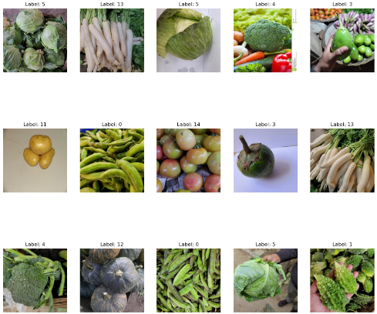
Experiments
The dataset used comes from Vegetable Image Dataset (kaggle.com). The vegetables that are chosen for the experimentation are- bean, bitter gourd, bottle gourd, brinjal, broccoli, cabbage, capsicum, carrot, cauliflower, cucumber, papaya, potato, pumpkin, radish and tomato. A total of 21000 images from 15 classes are used where each class contains 1400 images of size 224×224 and in *.jpg format. The dataset split 70% for training, 15% for validation, and 15% for testing purpose.

Slide 9
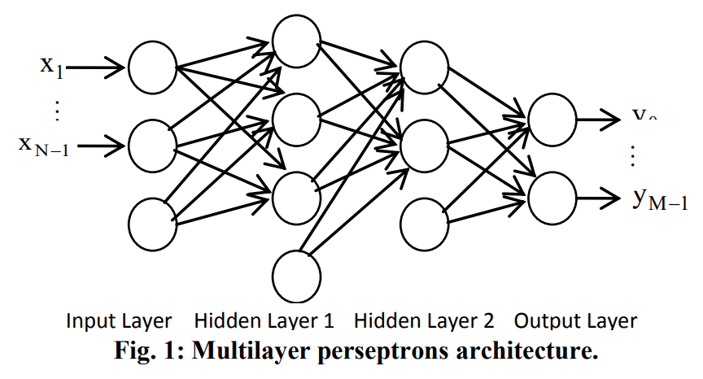
Experiments
In the MLP model architecture, there are 3 layers, namely the input layer, hidden layer and output layer. The first layer is the input layer that will receive input data. Furthermore, there is a hidden layer which is the second layer in the MLP model architecture. After passing through the hidden layer, the output of the hidden layer will be forwarded to the output layer. The output layer is the last layer of the model.

Slide 10
Experiments
The neural network model optimization process was carried out with 9 trials.
Hyperparams | Train Acc | Valid Acc | Train Loss | Valid Loss
64*64/LR 0.001/Grayscale/Batch Size 32/Hidden Layer 100 | 35.44 | 35.23 | 2.13 | 2.1
64*64/LR 0.1/Grayscale/Batch Size 32/Hidden Layer 100 | 54.18 | 45.59 | 1.42 | 1.89
32*32/LR 0.1/Grayscale/ Batch Size 32/Hidden Layer 100 | 79.31 | 61.26 | 0.67 | 1.6
20*20/LR 0.1/Grayscale/ Batch Size 32/Hidden Layer 100 | 82.90 | 69.43 | 0.56 | 1.13
20*20/LR 0.1/Grayscale/ Batch Size 64/Hidden Layer 200 | 86.82 | 70.66 | 0.41 | 1.08
30*30/LR 0.1/RGB/Batch Size 32/Hidden Layer 200 | 97.01 | 86.40 | 0.10 | 0.68
30*30/ LR 0.1/RGB/Batch Size 64/Hidden Layer 200 | 99.70 | 90.33 | 0.02 | 0.40
MLP with Dropout | 85.52 | 79.56 | 0.48 | 0.77
MLP Adam | 88.40 | 79.66 | 0.44 | 0.67

Slide 11
Result and Discussions
Notes:
Transisi antar outline

Slide 12
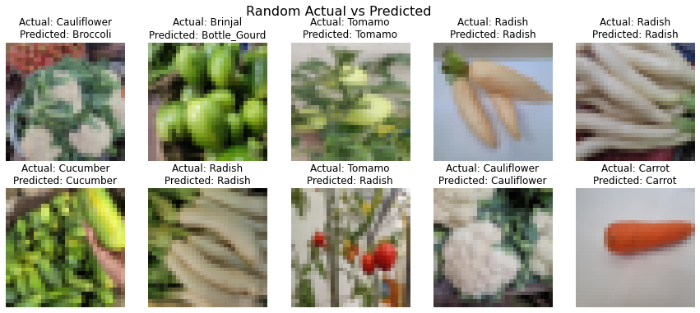
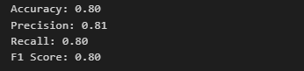
Result and Discussions
The experimental results show a reasonable progression in model performance with variations in parameters and optimization techniques. There is an improvement in Train Accuracy and Validation Accuracy with changes in hyperparameters such as image size, batch size, and hidden layer. Significant improvement was seen in the model using MLP with Adam optimizer, where it achieved Train Accuracy of 88.40% and Validation Accuracy of 79.66%.

Slide 13
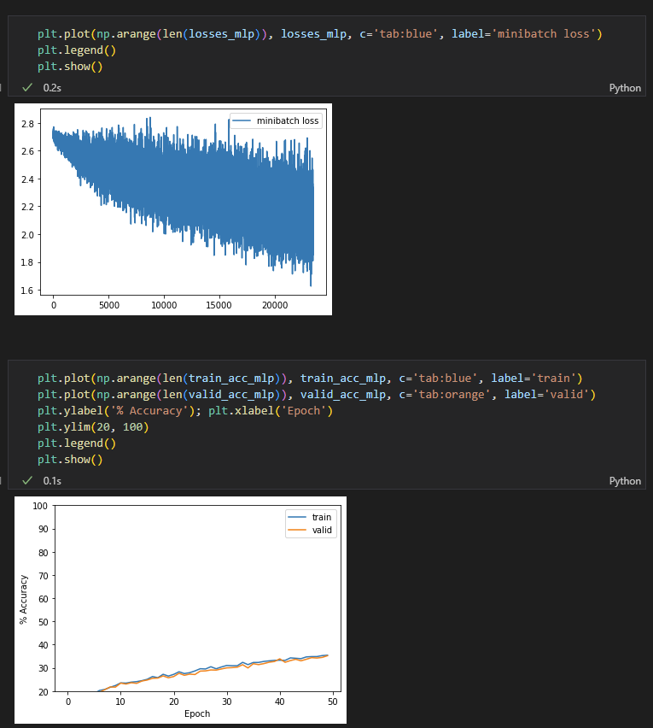
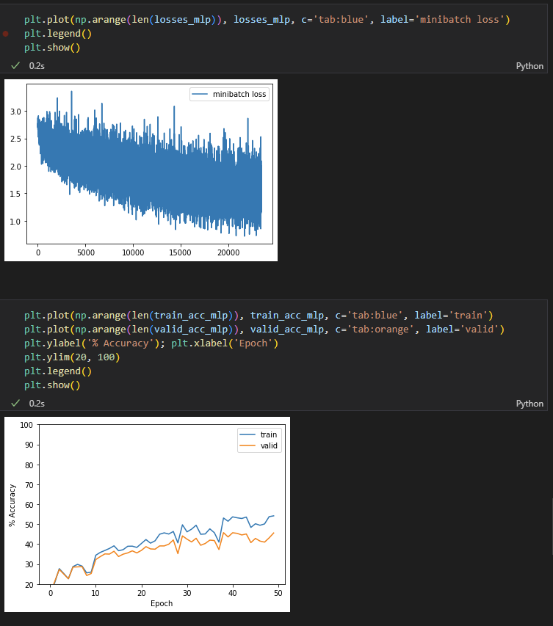
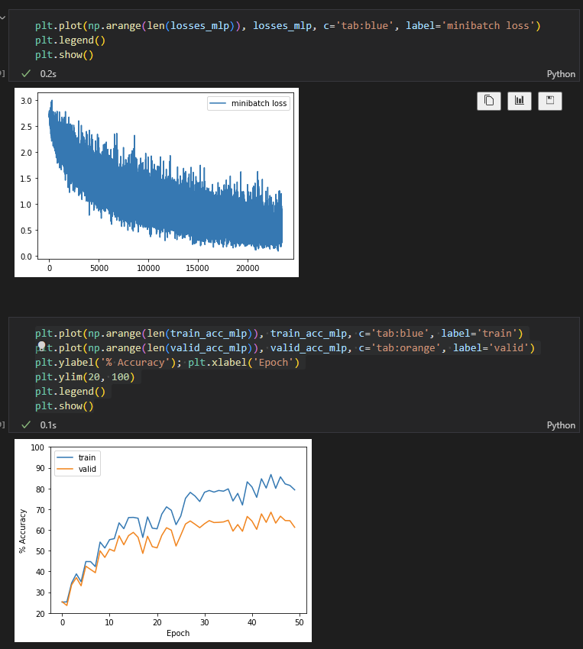
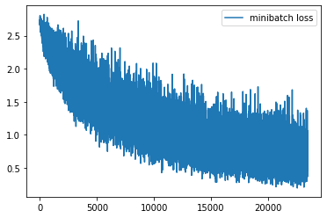
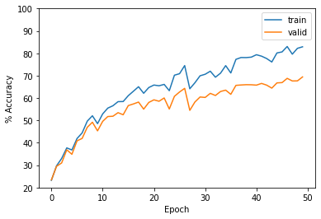
Result and Discussions
Experiment 1 Experiment 2
Experiment 3 Experiment 4

Slide 14
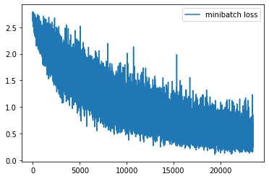
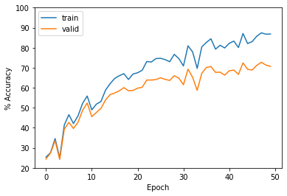
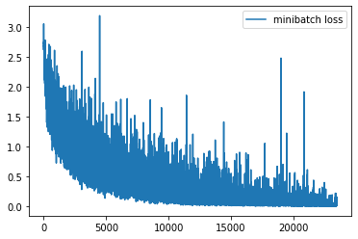
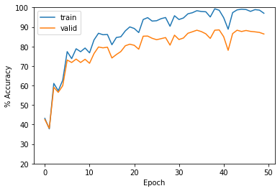
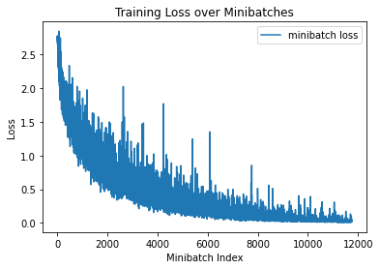
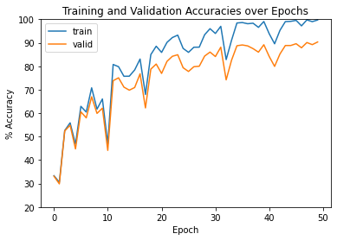
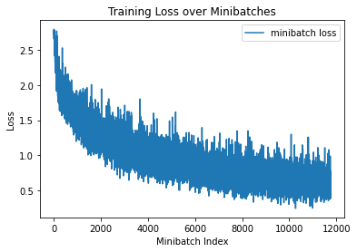
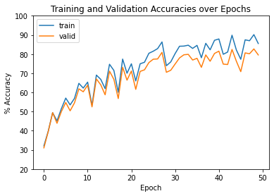
Result and Discussions
Experiment 5 Experiment 6
Experiment 7 Experiment 8

Slide 15
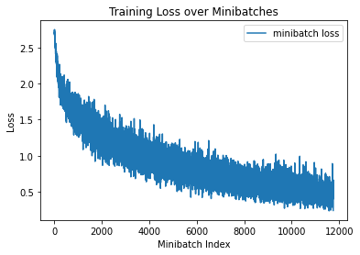
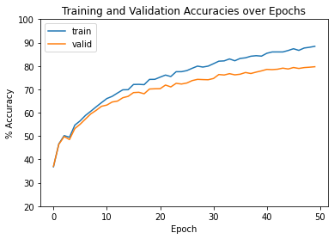
Result and Discussions
Experiment 9

Slide 16
Conclusion
Notes:
Transisi antar outline

Slide 17
Conclusion
Based on the experimental results, it can be concluded that the Multilayer Perceptron MLP model with Adam optimizer shows good performance. The model is effective in learning patterns from training data, reflected by the increased accuracy on the validation dataset. The use of Adam optimizer is effective in overcoming overfitting problems and accelerating model convergence. MLP model with Adam optimizer achieved training accuracy of 88.40% and validation of 79.66%. However, hyperparameter selection can be a complex process and the results obtained may vary depending on the dataset used.

Slide 18
References
Khalid M. Alrajeh, Tamer. A. A. Alzohairy.2012. Date Fruits Classification using MLP and RBF Neural Network. International Journal of Computer Applications (0975 – 8887) Volume 41– No.10, March 2012.
M. ISrak Ahmed, Shahriyar Mahmud Mamun, Asif Uz Zaman Asif.2021. DCNN-Based Vegetable Image Classification Using Transfer Learning: A Comparative Study. International Conference on Computer, Communication and Signal Processing (ICCCSP - 2021).
Sukhetha P, Hemalatha N, and Raji Sukuma.2021. Classification of fruits and vegetables using ResNet model. AgriRxiv 2021.
Yuki Sakai, Tetsuya Oda, Makoto Ikeda and Leonard Barolli.2016. A Vegetable Category Recognition System Using Deep Neural Network. International Conference on Innovative Mobile and Internet Services in Ubiquitous Computing.

Slide 19
Thank You
Notes:
Transisi antar outline

